Slide 1
Your Miami Coffee Shop

Slide 2
Goal
We are trying to help you narrow down the potential locations for a new coffee shop around downtown Miami.

Slide 3
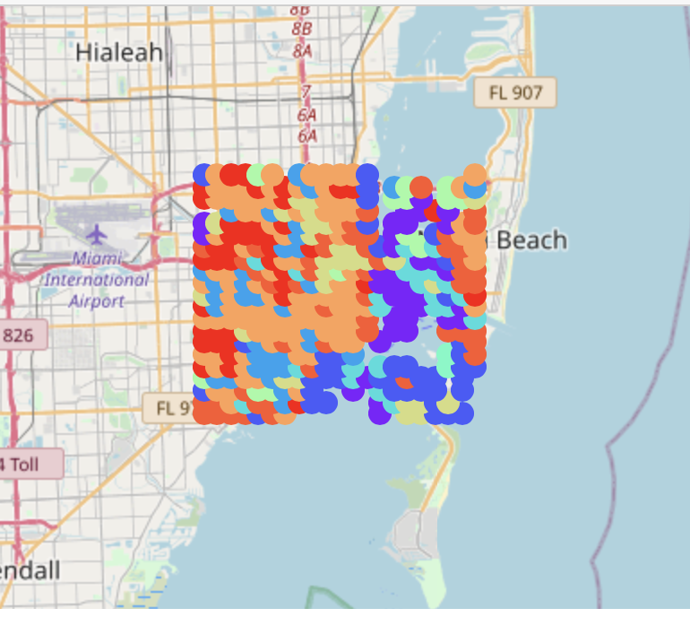
Locations
We examined over 400 ‘neighborhoods’ in an area 10km by 10km around downtown Miami

Slide 4
Finding the best ‘neighborhood’
To find the best areas to open a coffee shop we compared each of the over 400 neighborhoods to the areas surrounding existing coffee shops
The neighborhoods that were most similar to those with existing coffee shops were further edited by choosing those with the highest ratio of restaurants and shops to coffee shops

Slide 5
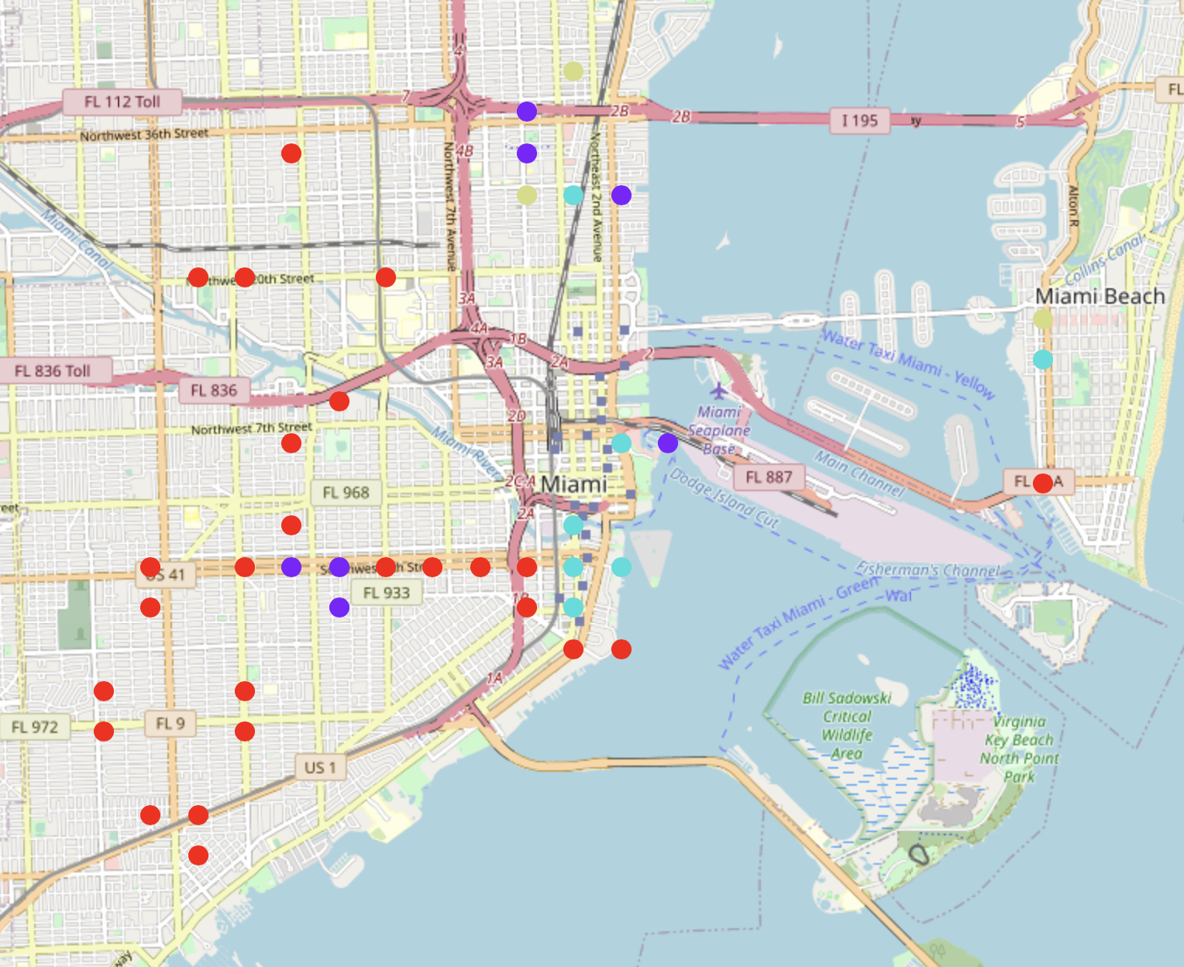
Best areas for a new coffee shop
These are some of the preferred areas to open a new coffee shop
Around the Shops at Midtown
North of the Financial District
Along US41 just west of I-95

